Slide 1

Masters of Aerospace Engineering Research Project
Numerical Analysis and Optimization of a Morphing Wing
By:
Prajwal Karinja Haridas
Tutors:
Joseph Morlier
Simone Coniglio

Slide 2
Contents
Introduction : Topology Optimization
Introduction : Numerical Analysis
State of Art
Solid Isotropic Material with Penalization (SIMP)
Moving Node Approach(MNA)
Method of Moving Asymptotes(MMA)
Generalized Geometry Projection(GGP)
Problem Statement
Finite element analysis
Sensitivity analysis and density filtering
Stress evaluation
Results
Conclusion and future work
References

Slide 3
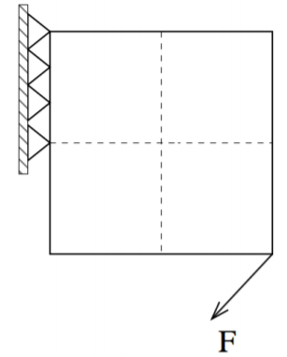
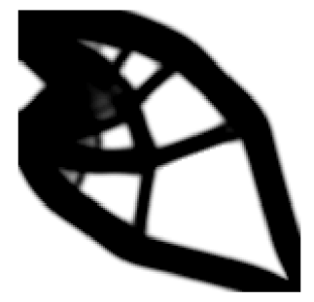
Introduction : Topology Optimization
Structural Topology optimization aims at optimizing the distribution of material in any specific design domain for given set of loads, constraints such that certain properties like compliance, stress bearing ability are optimized.
The approaches are extended to wide range of physical disciplines such as acoustics, electromagnetics and optics.[Guo et al,JAM,2014]
Topology optimization has already been implemented in commercial software to solve practical design optimization problems.
A sample example of Top Opt run with the help of 88 line of code

Slide 4
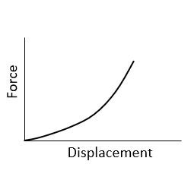
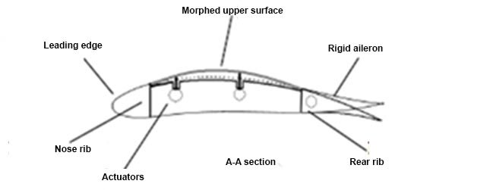
Introduction : Numerical Analysis
The numerical analysis based on non-linear mechanics is done on Morphing wing.
Approximate solution is desired based on Finite element method as it reduces time and cost.
Advantages of Morphing wing,
Aerodynamic benefits in drag and vibration
Improves the flexibility.
2 types of Morphing
Planform
Performance
Non-linear mechanics
[Kim et all,2015]
Morphing wing
[Tchatchuen et al, 2015]
Notes:
Planform morphing, where the planform of the wings are changed mid-flight in order to adjust to the change of mission and performance morphing, where the planform stays same but its shape and performance can be changed by adjusting the twist and bending along the wingspan or the change in camber.

Slide 5
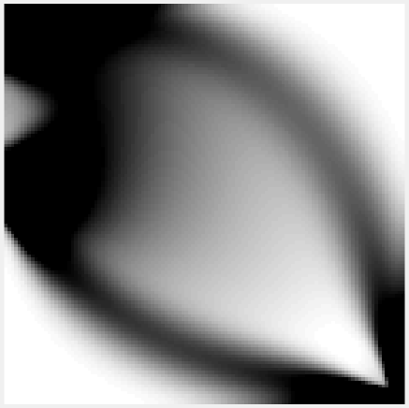
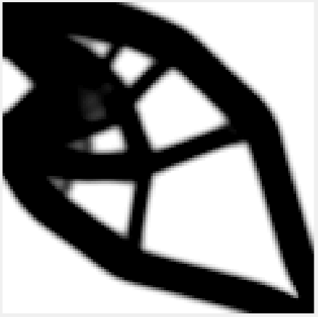
State of Art:
Solid Isotropic Material with Penalization (SIMP)
This method uses penalization which makes the intermediate densities smaller .[1,Bendose et al,AAM,1999]
The value of this penalty is generally p ≥ 3 and changed accordingly.
This penalty factor p, increase the cost of intermediate density elements and decrease the number of intermediate density elements.
Applying penalty of p=3, the grey area is reduced significantly

Slide 6
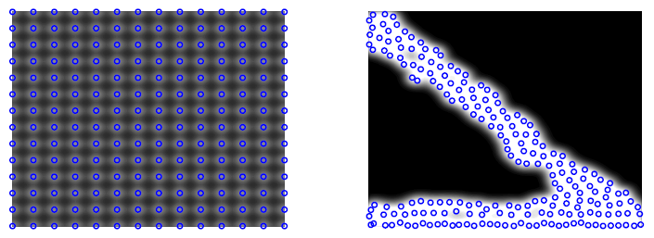
State of Art:
Moving Node Approach(MNA)
In this method the structures are optimized by varying different parameters between components.[5]
The main thought process for this method is to reduce the number of input variables and also to minimize the degrees of freedom.
The local density is then computed and the densities are summed to find the total density between components.
Redistribution of mass nodes illustrating the MNA approach.[5]

Slide 7
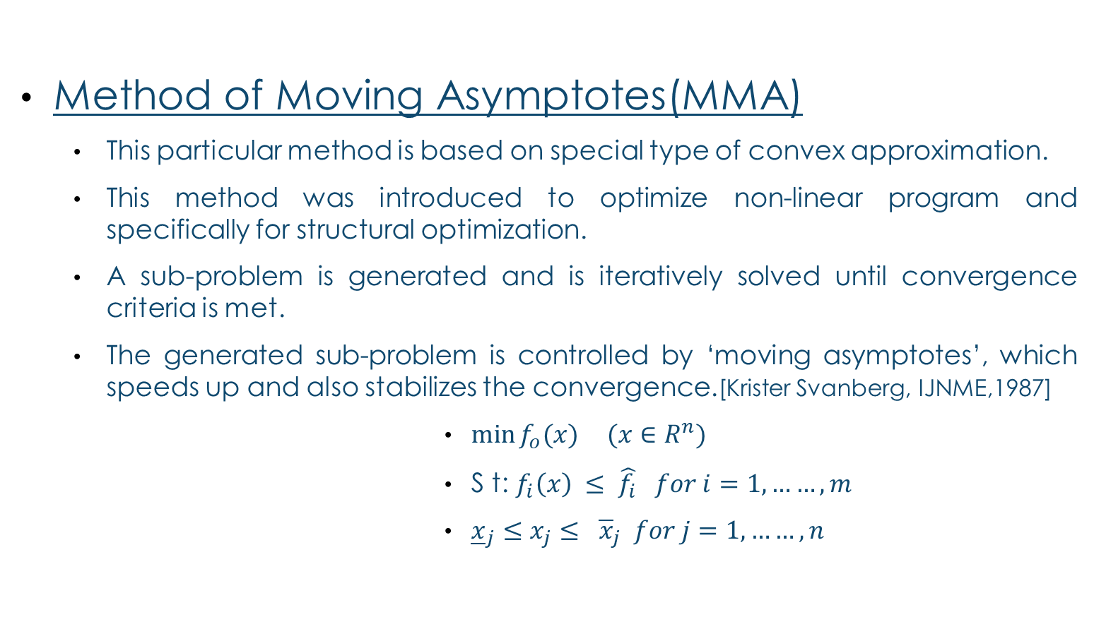
State of Art:
Method of Moving Asymptotes(MMA)
This particular method is based on special type of convex approximation.
This method was introduced to optimize non-linear program and specifically for structural optimization.
A sub-problem is generated and is iteratively solved until convergence criteria is met.
The generated sub-problem is controlled by ‘moving asymptotes’, which speeds up and also stabilizes the convergence.[Krister Svanberg, IJNME,1987]
$\min{f_{o}(x)} (x∈R^{n})$
S t: $f_{i}\left(x\right) ≤ \hat{f_{i}} for i=1,……,m$
${\underline{x}}_{j}≤x_{j}≤ {\overline{x}}_{j} for j=1,……,n$

Slide 8
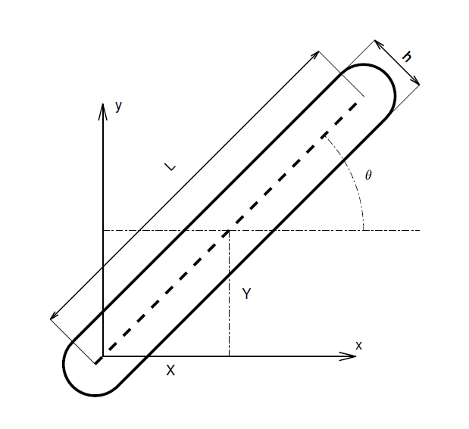
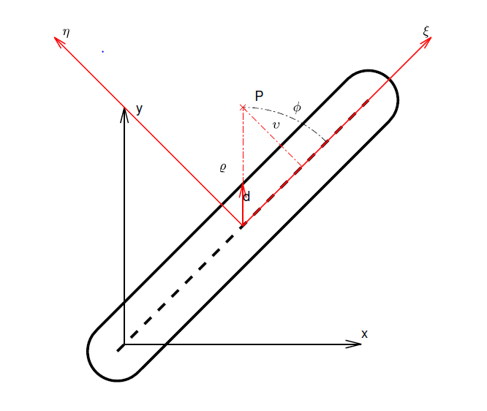
State of Art:
Generalized Geometry Projection(GGP)
Components considered changes size, position and orientations.
3 main methodologies used are GP, MMC and MNA.
A single process is formulated theoretically which considers all the above techniques.
Generalized Geometry Projection is proposed for geometric feature based topology optimization. [Coniglio et al,2019]
Geometric parameters of the component

Slide 9
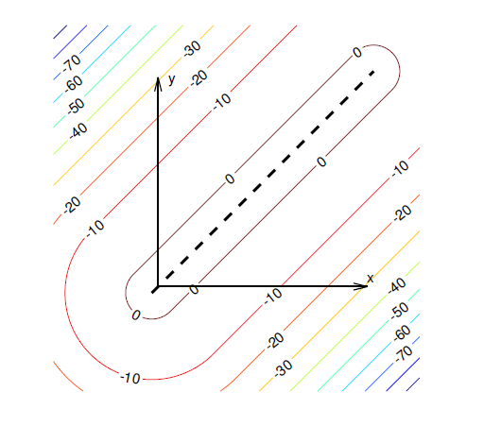

Classical equation which minimizes the compliance of the structure is considered
$\min_{\{x\}}C={\{U\}}^{T}${F}
S.t. $V=\frac{\sum_{el=1}^{N}{ρ^{el}}}{N}≤V_{0}$, $V_{0}$ is the max. volume fraction
$\left\{l_{b}\right\}≤\left\{x\right\}≤\{u_{b}\}$, $\left\{l_{b}\right\} and \{u_{b}\}$ are the lower and upper bounds.
In MMC, Topology Description Function(TDF) is used from the level set method, where it is positive inside the occupied area, 0 on the boundary and negative outside.
TDF is $X_{i}=1− {\left(\frac{{4v}_{i}^{2}}{h_{i}^{2}}\right)}^{α}with α≥1$
$D_{g}^{MMC}= \left\{\left\{X_{g}\right\}|\frac{h}{2}{\left(1−ε\right)}^{\frac{1}{2α}}≤v ≤\frac{h}{2}{\left(1+ε\right)}^{\frac{1}{2α}}\right\}$
$w_{g}^{MMC}=\frac{h}{2}{[\left(1−ε\right)}^{\frac{1}{2α}} −$ ${\left(1+ε\right)}^{\frac{1}{2α}}]$
Contour plot of generic component

Slide 10
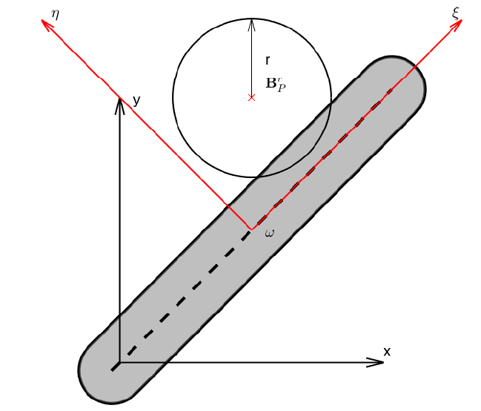

In GP, the distance between the element central point and the component surface is calculated.
The local volume fraction is the fraction of the material inside the window to the total window.
$$δ_{i}^{el}= \frac{\left|B_{P}^{r} ∩ ω_{i}\right|}{\left|B_{P}^{r}\right|}$$
$$D_{g}^{GP}= \left\{\left\{X_{g}\right\}|\frac{h}{2}−r≤v ≤\frac{h}{2}+r\right\}$$
$$w_{g}^{GP}=2r$$
$w\left(v,h,ε\right)=\left\{\begin{aligned}1, if v≤l, \\ a_{3}v^{3}+a_{2}v^{2}+a_{1}v+ a_{0 }, if l<v<u, \\ 0, otherwise\end{aligned}\right.$
$$D_{g}^{MNA}= \left\{\left\{X_{g}\right\}|\frac{h−ε}{2}≤v ≤\frac{h+ε}{2}\right\}$$
$$w_{g}^{MNA}=ε$$

Slide 11

In GGP, round ended bars are used as the geometric primitives.
A regular approximation of $γ$ is chosen in order to improve the functions regularity $W_{i}\left(\left\{X_{g}\right\},\left\{X_{i}\right\},\left\{r\right\}\right)$
$$\left\{\begin{aligned}0≤W_{i}\left(\left\{X_{g}\right\},\left\{X_{i}\right\},\left\{r\right\}\right)≤1 \\ \lim_{r→λ}W_{i}\left(\left\{X_{g}\right\},\left\{X_{i}\right\},\left\{r\right\}\right)=γ\left(\left\{X_{g}\right\}, ω_{i}\right) \\ W_{i}\left(\left\{X_{g}\right\},\left\{X_{i}\right\},\left\{r\right\}\right) ∈ C^{1}\left(R^{dg}\right)\end{aligned}\right.$$
Model response depends on geometric functions and gauss points.
Increasing component transition width, refining the mesh, using GGP are the few strategies.

Slide 12
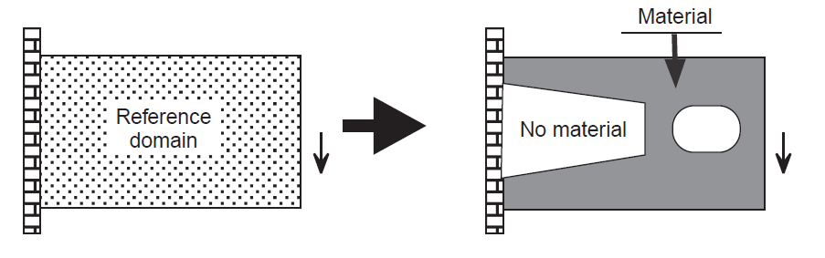
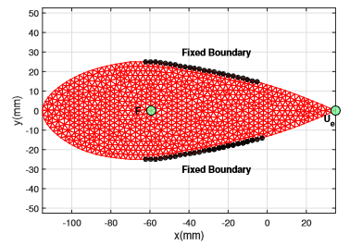

Problem statement:
Topology optimization
$\min_{u ∈ U, Θ}{\int_{Ω}{ρu.dΩ}}+\int_{Γ_{T}}{tu.ds}$
Subject to , $\int_{Ω}{C_{\ddot{y}kl}\left(x\right)ε_{ij}\left(u\right)ε_{kl}\left(v\right)⋅ⅆΩ}=\int_{Ω}{ρv.dΩ+ \int_{Γ_{T}}{tv.ds for all v∈ U}}$
$C_{ijkl}\left(x\right)= Θ\left(x\right)C_{ijkl}^{0} ; Θ\left(x\right)= \left\{\begin{aligned}1 if x∈ Ω^{m}, \\ 0 if x∈ Ω\backslash Ω^{m},\end{aligned}\right.$
$Vol\left(Ω^{m}\right)= \int_{Ω}{Θ\left(x\right).dΩ≤V} ; Geo\left(Ω^{m}\right)≤K$
Numerical analysis
minimize V($ρ$)
Subject to, $U_{e}\left(ρ\right)≥U_{0}$
$σ_{i}(ρ,U_{f}(ρ))≤σ_{lim}$
The potential density for elastomeric non-linear material is
$$Φ=\frac{1}{2}λ_{0}{\left[\ln\left(J\right)\right]}^{2}−μ_{0}\ln\left(J\right)+\frac{1}{2}μ_{0}\left[tr\left(C\right)−3\right]$$
$$with J=\det\left(F\right) F=\frac{dx}{dX} C=F^{T}F$$
[Pedersen et al, 2001]

Slide 13
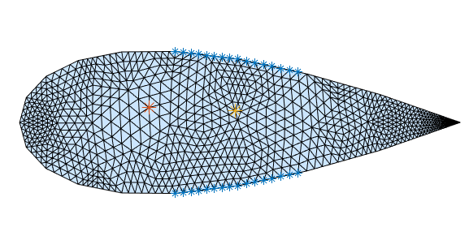
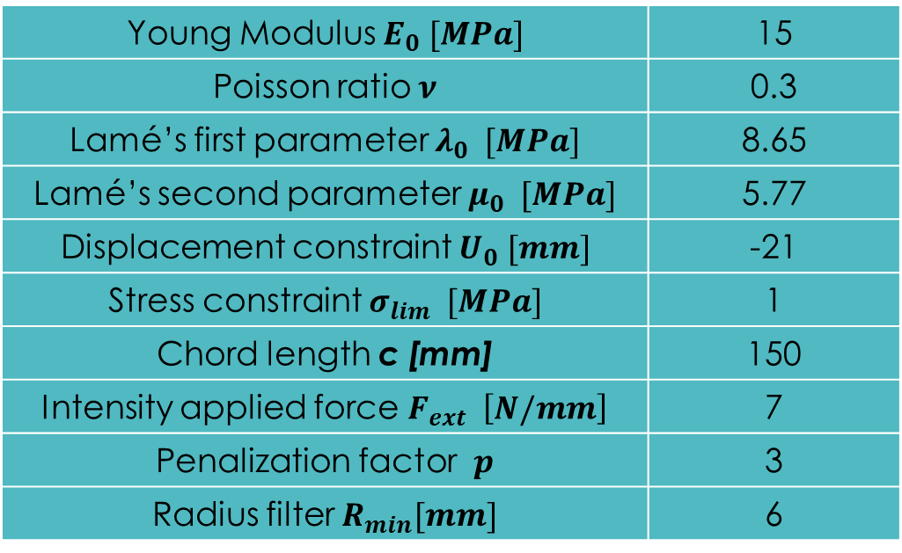
Problem statement:
Young Modulus $E_{0} [MPa]$ | 15
Poisson ratio $ν$ | 0.3
Lamé’s first parameter $λ_{0} [MPa]$ | 8.65
Lamé’s second parameter $μ_{0} [MPa]$ | 5.77
Displacement constraint $U_{0} [mm]$ | -21
Stress constraint $σ_{lim} [MPa]$ | 1
Chord length c [mm] | 150
Intensity applied force $F_{ext} \left[N/mm\right]$ | 7
Penalization factor $p$ | 3
Radius filter $R_{min}[mm]$ | 6
Domain description with the BC and forces acting

Slide 14
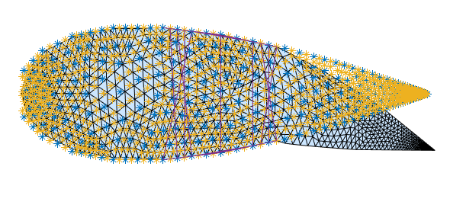

Finite element analysis:
Treating it as a minimization problem
For given BC and constraints, total energy has to be minimized
$The total energy, E_{tot}= \int{φdΩ − }F_{ext}U_{app}$
$R= F_{int}− F_{ext}, where F_{int}= \int{\frac{dφ}{{dq}^{T}}dΩ}$
$Hessian function, K_{T}=\int{\frac{d^{2}Φ}{{dqdq}^{T}}dΩ}= \frac{dR}{dq}$
q vector of nodal displacements
The tool ‘fmincon’ constrained minimization problem
Makes it fast and reliable
Deformed and undeformed structure

Slide 15

Sensitivity analysis and density filtering:
Density distribution and nodal displacements are used for this.
The Lagrangian augmented function
$L=f+λ^{T}R$
$λ^{T}=−\frac{∂f}{∂U_{F}}K_{T}^{−1}=\frac{∂f}{∂U_{F}}\frac{{∂R}^{−1}}{∂U_{F}}$
$\frac{dL}{dρ}=\frac{∂f}{∂ρ}+λ^{T}\frac{∂R}{∂ρ}$
The distinction of physical density and numerical density is given by
$ρ_{ij}=\frac{\sum_{i}{w_{ij}x_{i}}}{\sum_{i}{w_{ij}}}$
$w_{ij}=\max{(0, R_{min}−r_{ji})}$
$R_{min}$is the filter radius and $r_{ji}$ is the distance between the centroids of 2 elements

Slide 16

Stress evaluation
Plain strain hypothesis is considered
Second Piola-Kirchoff stress is taken and is computed in the reference configuration
$S=2\frac{∂φ}{∂C}= λ_{0}\log\left(J\right)C^{−1}+ μ_{0}(I−C^{−1})$
Relaxed strain constraint with N constraints.
${\overline{g}}_{i}=ρ_{i}\left(\frac{σ_{i}}{σ_{lim}}−1\right)≤0 ∀ i=1,…,N$
There are excessive constraints, so only max is considered.
${max\left({\overline{g}}_{i}\right) ≈G}_{KS}=\frac{1}{P}\log\left(\frac{1}{N}\sum_{i}^{N}{e^{P{\overline{g}}_{i}}}\right)$
Approximation of this $max\left({\overline{g}}_{i}\right)$ is done
Precision Cost

Slide 17
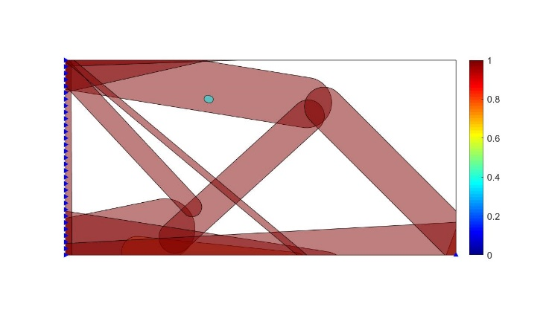
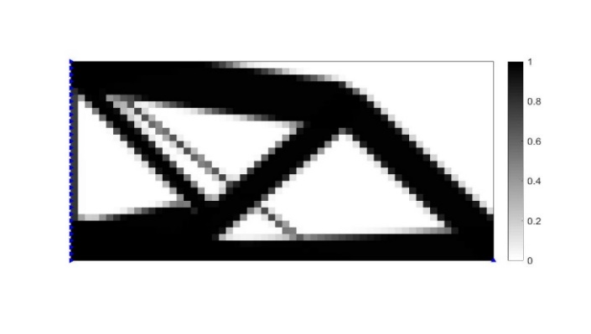
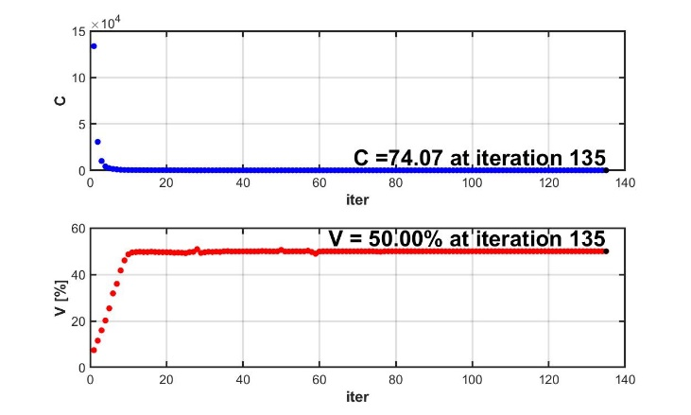
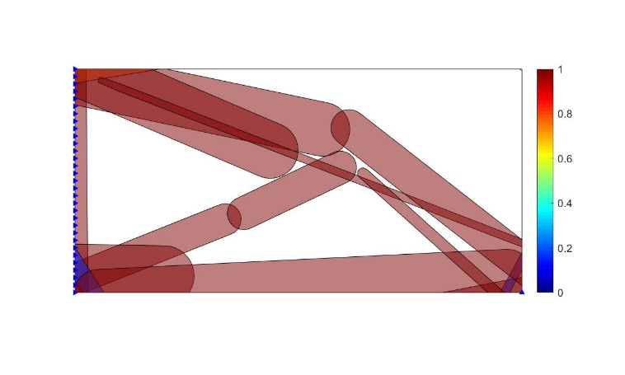
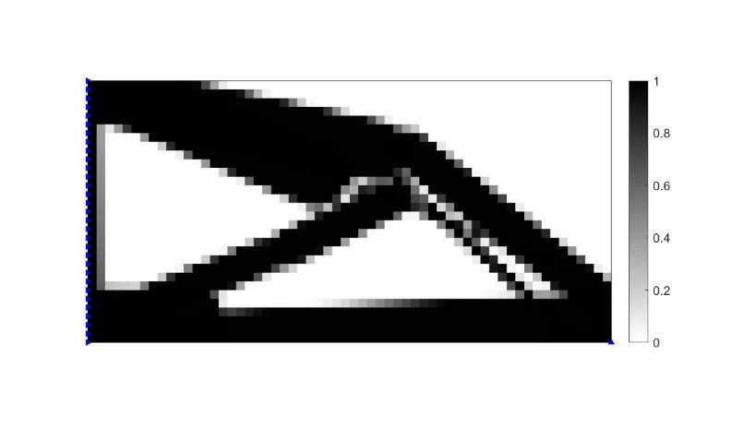
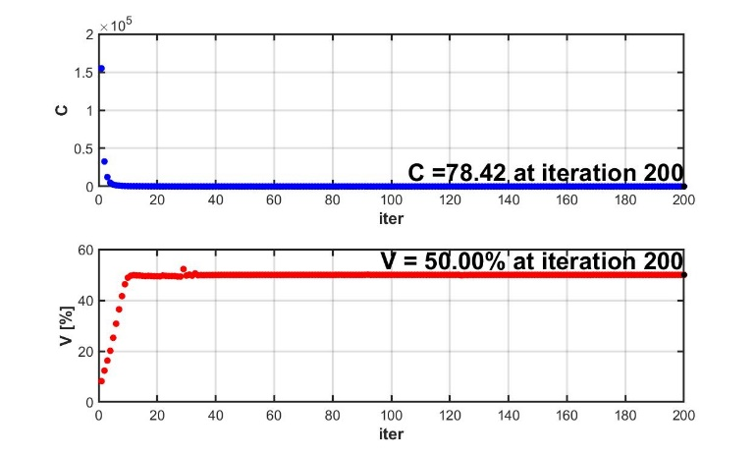
Results
Moving Morphable Bars(MBB) topology optimization using GGP for $N_{GP}=2 and R=0.5$ showing component plot, Density plot and Convergence plot
MBB topology optimization using GGP for $N_{GP}=1 and R=0.5$ showing component plot, Density plot and Convergence plot

Slide 18
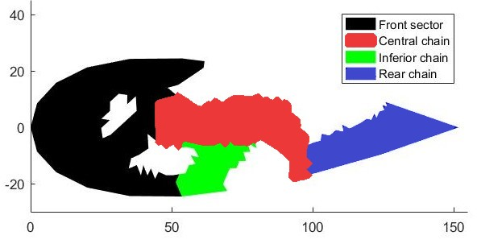
Results
There are 4 main sectors
Front sector: The primary role of the front sector is to transmit the stress throughout the domain
Central chain: It acts as the transmitter of load from the application point to the rear end where the deformation takes place
Inferior chain: It links the entire domain with the lower BC and also links with the front sector
Rear chain: It does not have any stress distribution. This is the region where the displacement occurs

Slide 19
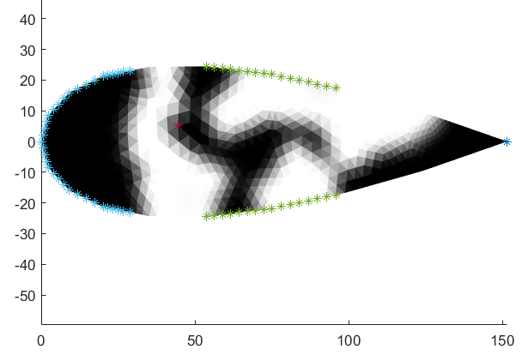
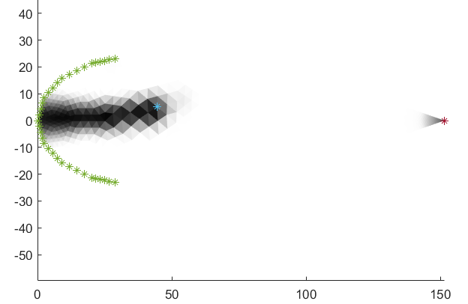
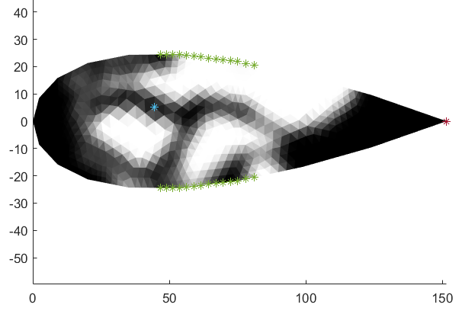
Results: Variation of BC and applied force
BC range: 35 - 65\% and 00 - 20\%
The front sector has very high material content which makes the structure heavier. Analysis can be made with some fine mesh
BC range 00-20\%
Without any boundary condition connecting the central and inferior chain, the material content available is nearly 0 which is not useful at all.
BC range 30-55\%
The front sector is penalized as a result the volume fraction increases. There is lot of grey area, especially at the junction where the front sector and the central chain is connected.

Slide 20
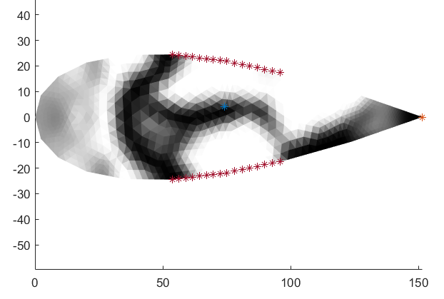
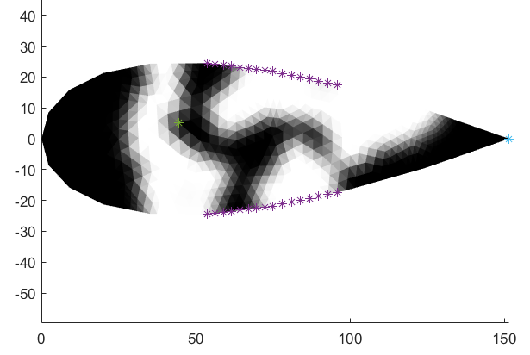
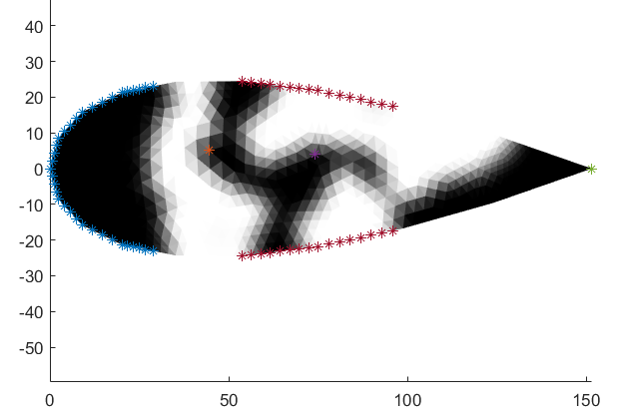
Results: Variation of BC and applied force
BC range: 35 - 65\% and force at 0.5
In this the load is much towards the right and as a result it is difficult to place the actuator. Further refinement is necessary because of the presence of the grey area
BC range 35-65\% and force at 0.3
This is the optimized case where the boundary is situated at an ideal location. The force acting on the domain is at 0.3. There is minimum grey area and very less stress concentration.
BC range 00 - 20\% and 35-65\% with force at 0.3 and 0.5
Topologically there is no much difference. So the addition of BC provides better support at the front but more computation is needed

Slide 21
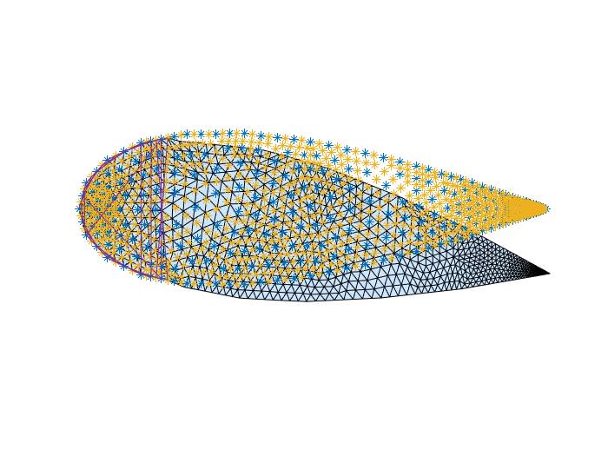
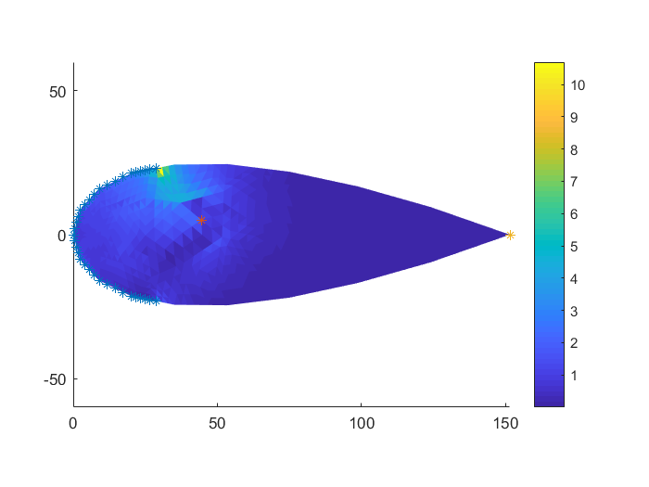
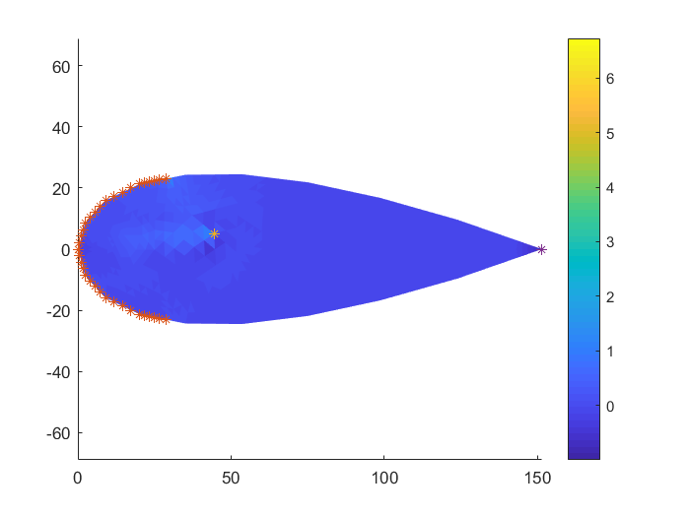
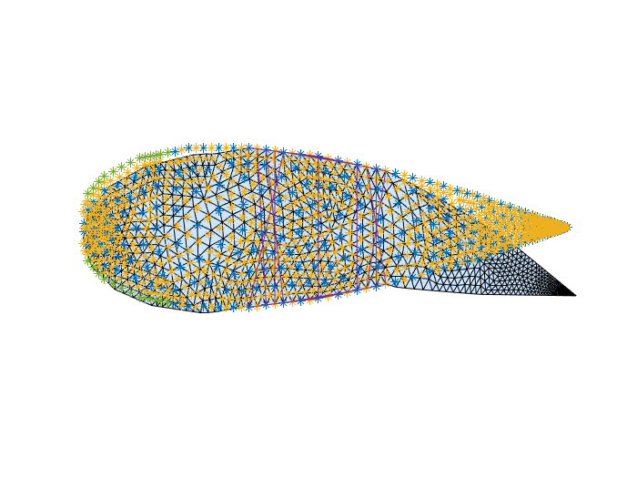
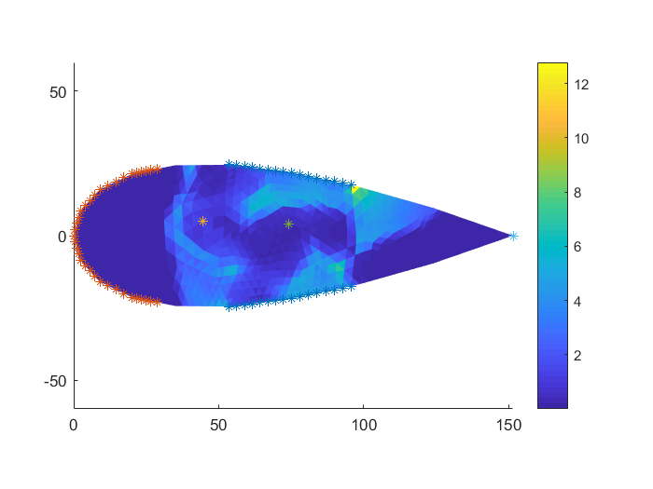
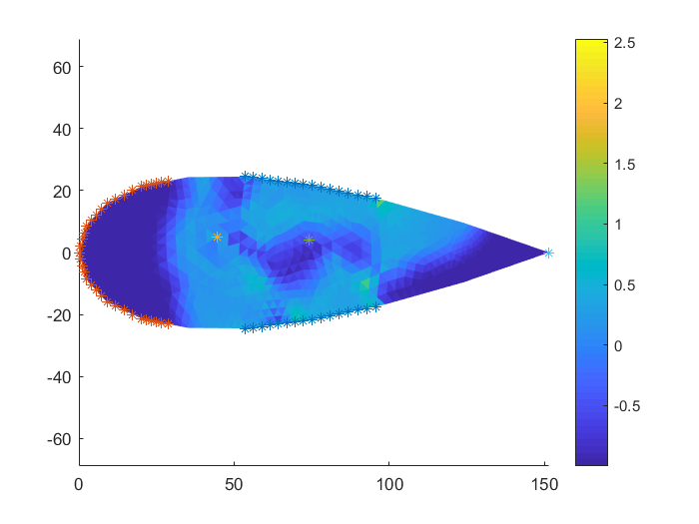
Results: Variation of BC and applied force
BC range: 00 - 20\%: Variation of stress and deformation
BC range: 00 - 20\% and 35 - 65\% with 2 forces: Variation of stress and deformation

Slide 22
Conclusion and future work
The main process of Topology Optimization and its different methods are understood.
The implementation of Generalized Geometry Projection for different methods and for different parameters.
Feasible morphing was analysed for different constraints.
The variation of boundary conditions and force has different effects on the topology.
Multiple forces are added and its position has a huge effect.
Higher force intensity results in numerical instabilities.
Many possibilities for future work including checking the effect on different kind of wing structure

Slide 23
References
Bendsoe, M. P., and Kikuchi, N., 1988, “Generating Optimal Topologies in Structural Design Using a Homogenization Method”, Computer methods in applied mechanics and engineering 71.2 (1988): 197-224.
Guo, Xu., Zhang, Weisheng., Zhong, Wenliang., (August 2014). “Doing Topology Optimization Explicitly and Geometrically—A New Moving Morphable Components Based Framework”, Journal of Applied Mechanics, Journal of Applied Mechanics 81.8 (2014): 081009.
Kong-Tian Zuo, Li-Ping Chen, Yun-Qing Zhang, Jingzhou Yang.(May 2005)- Manufacturing- and machining-based topology optimization, The international journal of advanced manufacturing technology 27.5-6 (2006): 531-536.
Krister Svanberg (1987) - THE METHOD OF MOVING ASYMPTOTES-A NEW METHOD FOR STRUCTURAL OPTIMIZATION, International journal for numerical methods in engineering 24.2 (1987): 359-373 .
Johannes T B Overvelde (April 2012) – The Moving Node Approach in Topology Optimization.
Tchatchueng Kammegne, M. J., Grigorie, L. T., Botez, R. M., “Design, Numerical Simulation and Experimental Testing of a Controlled Electrical Actuation System in a Real Aircraft Morphing Wing Model “, The Aeronautical Journal, Vol. 119,2015
C. B. W. Pedersen, T. Buhl, and O. Sigmund, “Topology synthesis of large-displacement compliant mechanisms,” International Journal for Numerical Methods in Engineering, vol. 50, no. 12, pp. 2683–2705, 2001.
A. Bhattacharyya, C. Conlan-Smith, and K. A. James, “Topology optimization of a bi-stable airfoil using nonlinear elasticity,” in 18th AIAA/ISSMO Multidisciplinary Analysis and Optimization Conference. American Institute of Aeronautics and Astronautics, Jun 2017
E. Andreassen, A. Clausen, M. Schevenels, B. S. Lazarov, and O. Sigmund, “Efficient topology optimization in MATLAB using 88 lines of code,” Structural and Multidisciplinary Optimization, vol. 43, no. 1, pp. 1–16, Nov 2010
N.-H. Kim, Introduction to Nonlinear Finite Element Analysis. Springer US, 2014

Slide 24
Thank you!

